Slide 1
Analysis of Different Sorting Algorithms
A Comparative Study

Slide 2
There are many popular problems in different practical fields of computer sciences, database applications, Networks and Artificial intelligence. One of these basic operations and problems is sorting algorithm; the sorting problem has attracted a great deal of research.
Abstract

Slide 3
Introduction
In computer science, a sorting algorithm is an algorithm that puts elements of a list into an order. The most frequently used orders are numerical order and lexicographical order, and either ascending or descending.
Large number of algorithms developed to improve sorting like merge sort, bubble sort, insertion sort, quick sort ,selection sort and others, each of them has a different mechanism to reorder elements which increase the performance and efficiency of the practical applications and reduce time complexity of each one.

Slide 4
PERFORMANCE IN AVERAGE CASE BETWEEN SORTING ALGORITHMS
There is no one sorting method that is best for every situation. Some of the factors to be considered in choosing a sorting algorithm include …
… the size of the list to be sorted, the programming effort, the number of words of main memory available, the size of disk or tape units, the extent to which the list is already ordered, and the distribution of values.
This paper implemented of …
Selection sort, Quick sort, Insertion sort , Merge sort ,Bubble sort and GCS algorithms
… using C++ programming language, and measure the execution time of all programs with the same input data using the same computer.

Slide 5
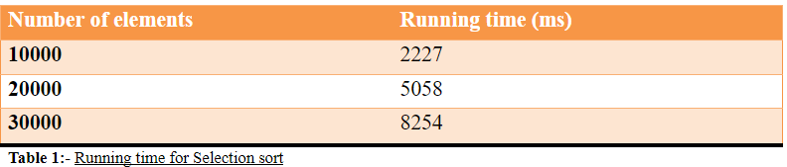
Selection
Sort
Selection sort is an in-place comparison sort.
It has O(n2) complexity, making it inefficient on large lists, and generally performs worse than the similar insertion sort.
Selection sort is noted for its simplicity.
The algorithm finds the minimum value, swaps it with the value in the first position, and repeats these steps for the remainder of the list.

Slide 6
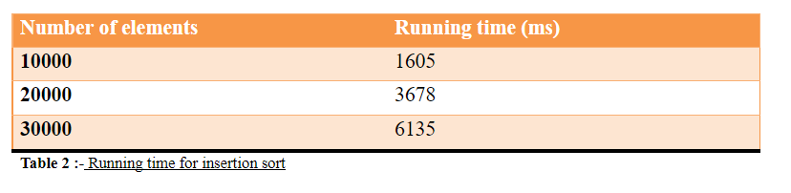
Insertion
Sort
Insertion sort is a simple sorting algorithm that is relatively efficient for small lists and mostly sorted lists.
It works by taking elements from the list one by one and inserting them in their correct position into a new sorted list similar to how we put money in our wallet.
In arrays, the new list and the remaining elements can share the array's space, but insertion is expensive, requiring shifting all following elements over by one.

Slide 7
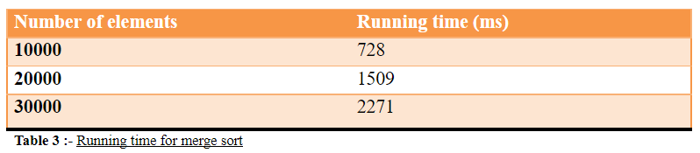
Merge
Sort
Merge sort takes advantage of the ease of merging already sorted lists into a new sorted list.
It starts by comparing every two elements (i.e., 1 with 2, then 3 with 4...) and swapping them if the first should come after the second.
It’s worst-case running time is… O(n log n).
It is also easily applied to lists, not only arrays, as it only requires sequential access, not random access.

Slide 8
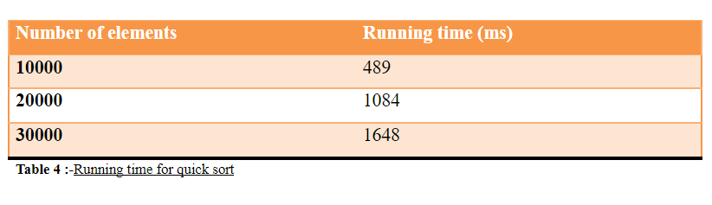
Quick
Sort
In this sort an element called pivot is identified and that element is fixed in its place by moving all the elements less than that to its left and all the elements greater than that to its right.
It's an O (n log n) Time complexity in average case.
In Table 4 the execution time and number of elements as follow:

Slide 9
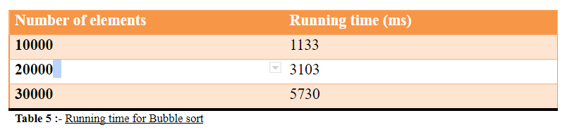
Bubble
Sort
Bubble sort is a simple sorting algorithm that works by repeatedly;
… it's comparing each pair of adjacent items and swapping them if they are in the wrong order.
This passing procedure is repeated until no swaps are required, indicating that the list is sorted.
It has a O (n2) Time complexity.

Slide 10
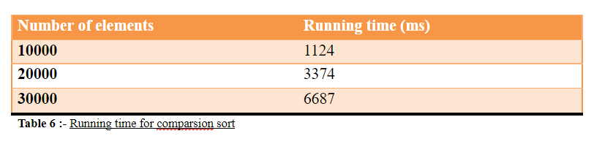
Grouping Comparison
Sort
In this sort we divide the list of elements into groups;
… each group contains three elements that compare with the first element of next groups.
It has a time complexity O (n2)

Slide 11
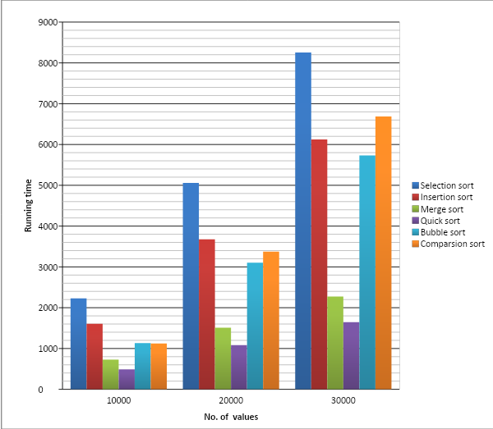
COMPARATIVE STUDY AND DISCUSSION
The Plot of length of input and CPU time taken (ms).
Result shows that for small input the performance for the six techniques is all most nearest, but for the large input Quicksort is the fastest and the selection sort the slowest.

Slide 12
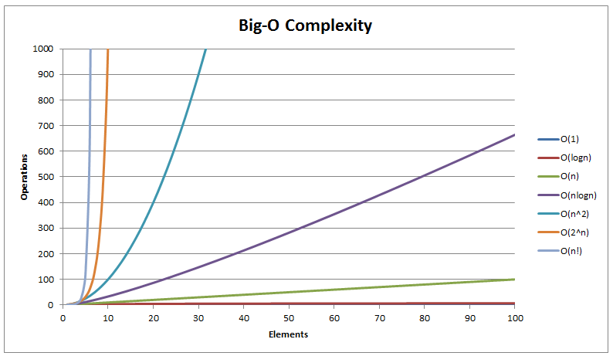
Complexity Comparison between Typical sorting algorithms
The comparison of complexity between GCS and conventional sort algorithms are listed in table7
GCS gave an additional method to manipulate information.

Slide 13
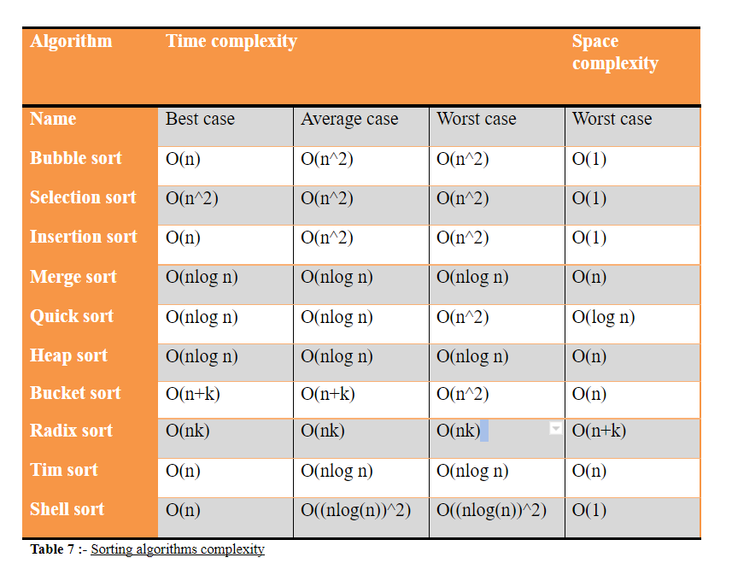
“This is a super-important quote”
- From an expert

Slide 14
CONCLUSION AND FUTURE WORK
This paper discuss a comparison between the new suggested algorithm (GCS) and selection sort, Insertion sort, merge sort, quick sort and bubble sort. It analysis the performance of these algorithms for the same number of elements (10000, 20000, 30000). For small input the performance for the six techniques is all most nearest, but for the large input Quick sort is the fastest and the selection sort the slowest. Comparison sort in average and worst case have the same time complexity with selection, Insertion and bubble sort.
This research is initial step for future work; in the future we will improve our algorithms Grouping Comparison Sort algorithms (GCS) to optimize software’s in searching method and retrieve data.

Slide 15

Thanks!
Student of Department of Computer Science and Engineering , Rajasthan Institute of Engineering Technology, Jaipur 302026, India.
Anil puri Goswami
Ankit Malpani
Vicky Kumar
Dr. Saroj Hiranwal (Mentor)

